Slide 1
First Class Restaurant Location Analysis:
Finding Optimal Locations within the United States
Sammie Haskin
Kennesaw State University
June 3, 2020

Slide 2

Introduction
The creation of a successful first-class restaurant franchise can hinge on a variety of geographic and sociodemographic factors:
identifying the target demographic
maximizing exposure to potential customers
accessibility
As a result the selection of an optimal location is paramount in the creation of a successful first-class restaurant.
Using multiple techniques in statistics and machine learning, the aim is to identify counties in which a first-class restaurant venture could be profitable

Slide 3
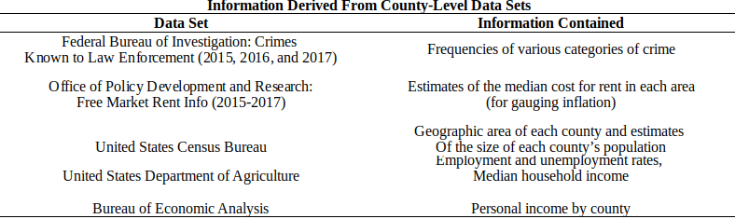
Data
Data were gathered from a variety of sources across 2772 counties and 46 states.
Using a variety of techniques and concepts in set theory, these data were integrated into one data set.
The sources gathered are as follows:

Slide 4
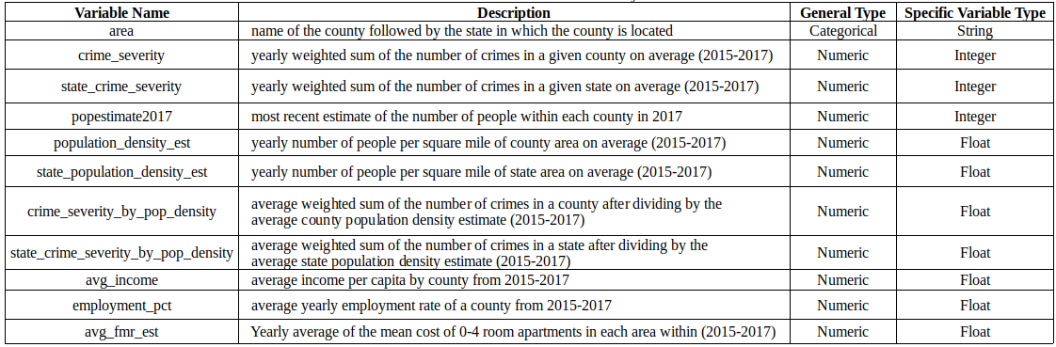
Data
Counties Data Dictionary
Utilizing the resulting data set, the assessed geographic and sociodemographic factors contained would be used for a variety of purposes in this analysis.

Slide 5
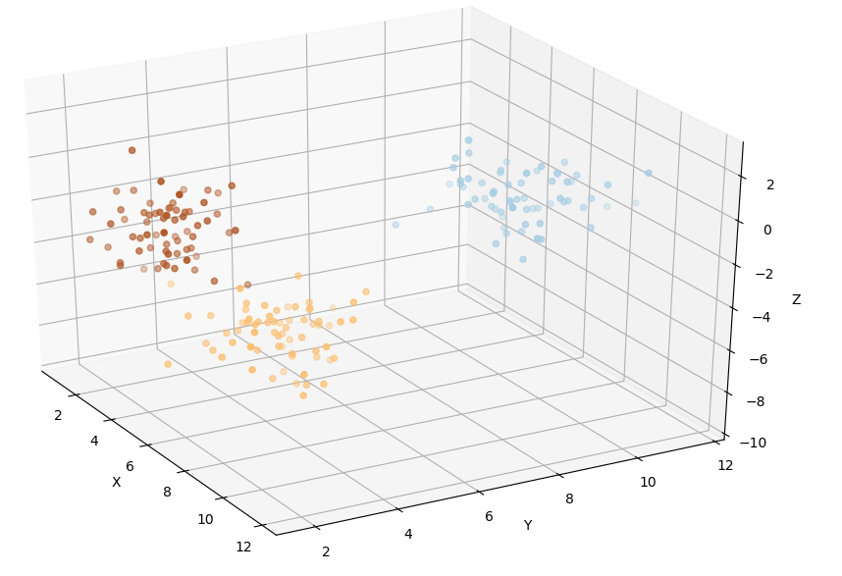
Methods
For the purposes of identifying clusters of similar counties within the data, density based spatial clustering of applications with noise (DBSCAN) was utilized.
The cluster of counties exhibiting the most optimal properties would subsequently be identified and further analyzed.

Slide 6
Methods
DBSCAN has several benefits over the K-Means clustering algorithm in that:
It makes no assumptions about the shape of each cluster.
It allows for the identification of the number of clusters in the data without prior specification.
Extremely differing observations can be identified as noise without assignment to a cluster.

Slide 7
Methods
The DBSCAN algorithm takes two parameters: epsilon, and minPts
epsilon - the minimum distance of each point from a cluster to be considered a member of that cluster
minPts - the total number of nearby points to consider the points as belonging to one cluster
The minPts parameter was first chosen using the heuristic of taking the natural logarithm of the sample size: ln(2772) ≈ 8
Utilizing principle components analysis with three components, a value for epsilon was chosen such that:
Unique clusters could be observed upon visualization with 3 components.
Observations that could be considered noise were not assigned to a cluster.
As necessary both parameters were revised through trial and error.

Slide 8
Methods
Once a cluster of similar counties exhibiting near optimal metrics was identified:
1) The inverse of crime severity was calculated such that lower scores denoted crimes of greater severity and higher scores denoted crimes of lesser severity.
2) The percentiles metric of each county was to be subsequently calculated.
3) An overall rank for each county was subsequently produced by finding the percentiles across all metrics.
Among all counties within the cluster that were above the 95th percentile, the top 10 ranked areas were to be further analyzed in terms of:
1) Proximity to businesses and tourist attractions
2) Competition from nearby groceries stores, delis and restaurants.

Slide 9
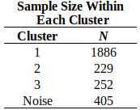
Results
Using DBSCAN with an eps of .41 and a "minPts" of 10, 3 unique clusters were revealed.
Viewing the total sample size in each cluster, the distribution sample of each cluster is as follows:

Slide 10
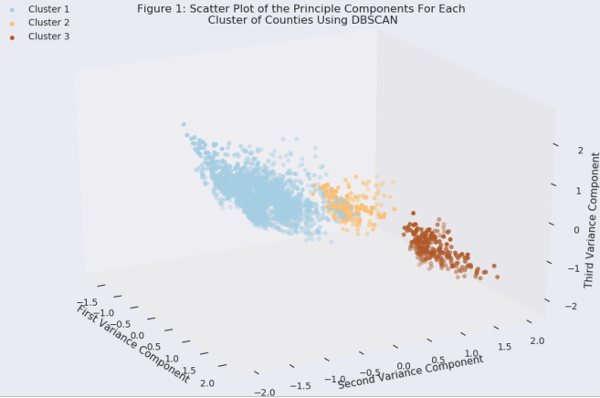
Results
Utilizing Principle Component Analysis, it was discovered that 3 factors accounted for 80.62% of the variance of across all variable used for clustering.
Viewing the resulting clusters using the principle components, the DBSCAN algorithm appeared to result in clusters that were distinct from each other and did not appear to cluster noise.

Slide 11
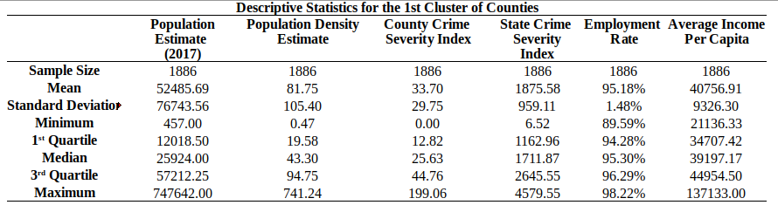
Results Cluster 1
Appeared to have a moderate yet variable population density.
State and county level crime
rates were extremely small
within this cluster.
Counties within this cluster had moderately large incomes per capita.
Counties within this cluster had average employment rates of which were similar to those of other clusters.

Slide 12
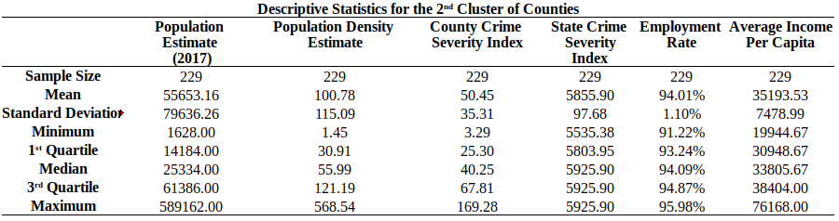
Results Cluster 2
Contained very large population densities on average.
State and county level crime
rates were moderately large
within this cluster.
Contained significantly lower incomes per capita than other clusters.
Counties within this cluster had slightly below average employment rates.

Slide 13
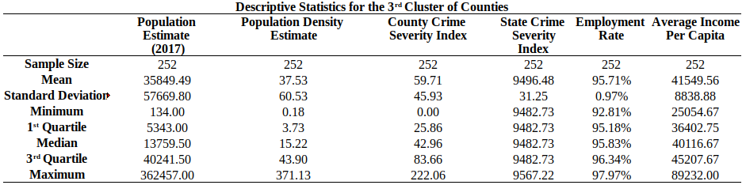
Results Cluster 3
Contained very small population densities on average.
State and county level crime
rates were extremely large
within this cluster.
Contained higher incomes per capita than other clusters. The difference was negligible, however.
Counties within this cluster had slightly above average employment rates.

Slide 14
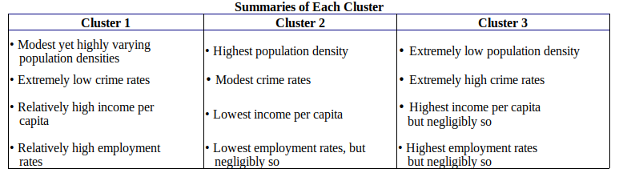
Results Summary of Each Cluster

Slide 15
Results Refining the List of Preferable Counties
Overall, counties within Cluster 1 exhibited a preferable combination of favorable characteristics
Containing 1882 counties, it was imperative to reduce the list of possible counties to only the most preferable.
Subsetting the list of counties from Cluster 1, 10 counties that generated incomes per capita above the 95th percentile were chosen for further analysis on the basis of their average percentile across each factor.

Slide 16
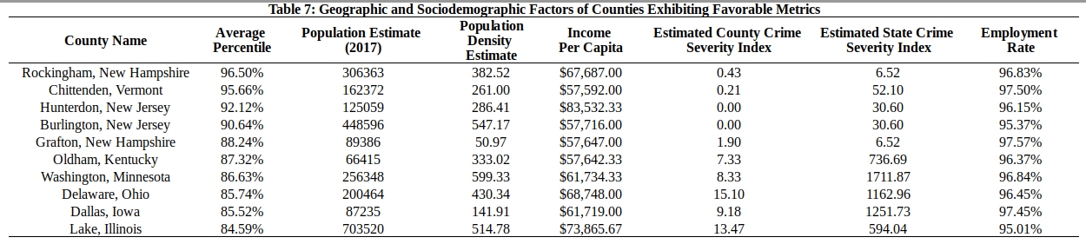
Results: Refining the List of Preferable Counties
The 10 counties that exhibited the most favorable metrics are as follows:

Slide 17
Results: Analysis of Area Attractions and Competition
Using the Foursquare api along with the coordinates of each county, the following information was gathered:
the number of nearby venues
the number of nearby restaurants
metrics as to the competitiveness (total likes and rating out of 10) of each restaurant within the area

Slide 18
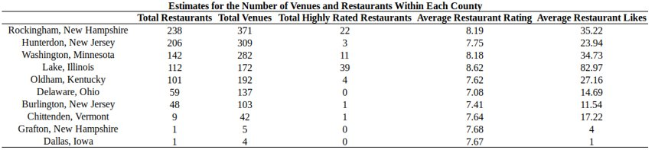
The following data combined with the previous metrics into these counties provide insight into the usefulness of each location in the creation of a first-class restaurant:

Slide 19
Results: Analysis of Area Attractions and Competition
As expected, densely populated counties with high income per capita also housed the most venues.
Such areas include: - Rockingham, New Hampshire - Hunterdon, New Jersey
- Washington, Minnesota - Delaware, Ohio - Lake, Illinois
Of these:
All contained a total of at least 170 venues of any type and at least 59 restaurants, food deli's, or bakeries.
Rockingham, Washington, and Lake Counties each contained at least 10 highly rated restaurants with ratings of at least 9 out of 10.
Delaware and Hunterdon contained 0 and 3 highly rated restaurants, respectively.

Slide 20
Results: Analysis of Area Attractions and Competition
Of the 10 counties, those that averaged no more than $58,000 income per capita contained a variable amount of venues as well as a sparsity of highly rated restaurants.
These areas include:
- Grafton, New Hampshire - Oldham, Kentucky - Chittenden, Vermont - Burlington, New Jersey
Of these:
Grafton, New Hampshire was sparsely populated and contained only 5 recorded venues and 1 of which was a restaurant.
Oldham, Kentucky contained a moderate population size within a densely populated area. This area contained a large amount of venues of any kind (192) and 101 of which were restaurants. Only four restaurants within the county were rated with a score of at least 9 out of 10.
Burlington, New Jersey was densely populated, containing a moderate amount of venues and restaurants, one restaurant of which received a rating greater than 9 out of 10.
Chittendenen, Vermont contained a moderately large population density, high the employment rates, and a moderate amount of venues (42) and a low amount of restaurants (9). Only one restaurant within the area was highly rated.

Slide 21
Results: Analysis of Area Attractions and Competition
The county of Dallas, Iowa, unlike the other 9 counties, contained:
A moderate size at 87235 persons.
A population density of 141 people per square mile.
An extremely low amount of restaurants and venues of any kind with totals of 1 and 4, respectively.
No restaurants that were rated as a 9 out of 10

Slide 22
Discussion
The counties of Rockingham, Lake, and Washington exhibit preferable metrics across:
crime rates
population size and density
income per capita
potential foot traffic as gauged by the number of businesses in the area.
Although these areas may attract potential customers:
The number of highly rated restaurants is multitudinous within these counties
As a result, nearby competition must be accounted for if creating a first-class restaurant within one of these counties.

Slide 23

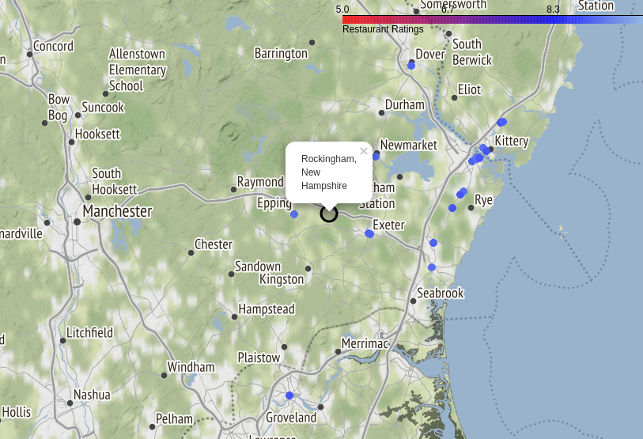
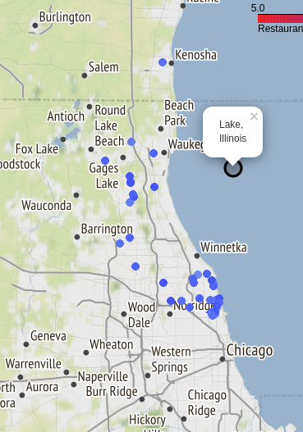
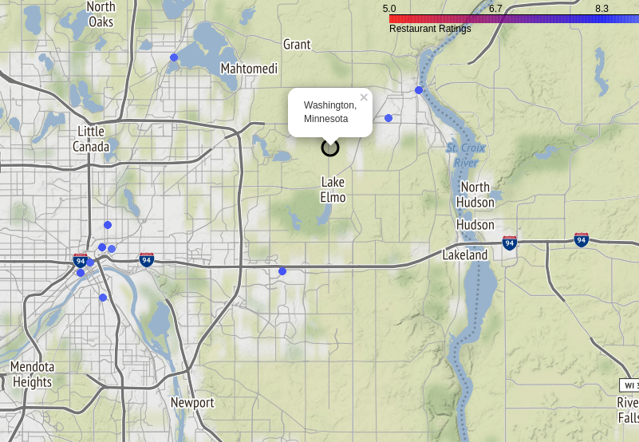
Discussion
The following plots display the locations of restaurants with ratings of at leest 9 out of 10.
Observing the locations of nearby competition:
Many high rated restaurants are centered close to large bodies of water.
It is possible that such areas may provide aesthetics that result in higher ratings than otherwise.
Careful analysis of the benefits and drawbacks of creating first class restaurants in proximity to these bodies of water

Slide 24
Discussion
In contrast, the remaining counties appear to have a lack of competition among highly rated restaurants:
Each area contains either no highly rated venues or no more than 3 highly rated venues.
Of these counties, the high income per capita, the busy economy, and the dearth of highly rated restaurants may prove profitable for the creation of a first-class restaurant within Hunterdon, New Jersey or Delaware, Ohio.
Careful thought must be given if setting a first-class restaurant within Chittenden, Grafton, Dallas, or Oldham, however:
Each of these areas contains either an income per capita below $60,000 or a relatively low amount of businesses that could boost foot traffic in the vicinity.

Slide 25
Conclusion
The DBSCAN algorithm was used for the identification of a cluster of potentially suitable areas for a first class restaurant.
Within this cluster, statistical procedures were used to derive and assess the suitability of 10 potentially viable counties.
Through the implementation of these procedures, a subset of counties exhibiting optimal properties were identified. As data is ever changing, such an analysis can be applied to re-evaluate preferable areas during the expansion of a successful franchise.

Slide 26
References
Blumstein, A. (1974). Seriousness Weights in an Index of Crime. American Sociological Review, 39(6), 854-864. Retrieved from http://www.jstor.org/stable/2094158
Bureau of Economic Analysis (2018). Personal Income by County, Metro, and Other Areas [Data file] Retrieved from https://www.bea.gov/data/income-saving/personal-income-county-metro-and-other-areas
* Federal Bureau of Investigation (2010). Crime in The United States. Retreived from https://ucr.fbi.gov/crime-in-the-u.s/2010/crime-in-the-u.s.-2010/violent-crime
Federal Bureau of Investigation (2015). Offenses Known to Law Enforcement by State by Metropolitan and Nonmetropolitan Counties [Data file]. Retrieved from https://ucr.fbi.gov/crime-in-the-u.s/2015/crime-in-the-u.s.-2015/offenses-known-to-law-enforcement/offenses-known-to-law-enforcement
Federal Bureau of Investigation (2016). Offenses Known to Law Enforcement by State by Metropolitan and Nonmetropolitan Counties [Data file]. Retrieved from https://ucr.fbi.gov/crime-in-the-u.s/2016/crime-in-the-u.s.-2016/tables/table-6/table-6.xls/view//
Federal Bureau of Investigation (2017). Offenses Known to Law Enforcement by State by Metropolitan and Nonmetropolitan Counties [Data file]. Retrieved from https://ucr.fbi.gov/crime-in-the-u.s/2017/crime-in-the-u.s.-2017/downloads/download-printable-files
Foursquare (n.d.) PlacesAPI. Retrieved from https://developer.foursquare.com/
Google. (n.d.). Maps Static API. Retrieved from https://maps.googleapis.com/maps/api/
Office of Policy Development and Research (2017). County Level Fair Market Rents [Data file]. Retrieved from https://www.huduser.gov/portal/datasets/fmr.html#2019_data
United States Census Bureau (2010). Population, Housing Units, Area, and Density: 2010 - United States -- County by State; and for Puerto Rico 2010 Census Summary File 1 [Data file]. Retrieved from https://factfinder.census.gov/faces/tableservices/jsf/pages/productview.xhtml?src=bkmk
United States Census Bureau (2017). City and Town Population Totals: 2010-2017 [Data file]. Retreived from https://www.census.gov/data/datasets/2017/demo/popest/total-cities-and-towns.html
United States Department of Agriculture (2018). Employment, Unemployment, and Median Household Income [Data file]. Retrieved from https://www.ers.usda.gov/data-products/county-level-data-sets/
* referenced but not used

